Slide 1
Sequence Diagrams

Slide 2
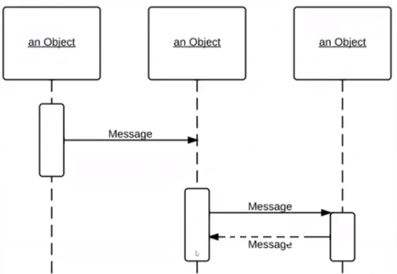
What a sequence diagram looks like
Object/ Partcicipant
Messages to/from objects
Activation
Lifeline

Slide 3
What are they for?
A Sequence diagram gives you a time sequence for what will happen as the result of an action of a user
They are so you can mark down a usage scenario (one instance of an action taking place) to see what outcomes will happen because of it
They are a planning tool
In essence, it is a way to draw a map which details what different object will do for each scenario a program can be presented with

Slide 4
How they work
Actor– This is the initiator of the action, generally the user. They will begin the process generally by doing some action, such as requesting information or trying to purchase goods.
Object – This is other entities in the program, such as classes. They will contain methods or attributes and interact with the actor or other objects in some way
The activation is a bar that symbolizes the object has become active and is alive. Once the bar ends, it means it is no longer in use.
The dotted line that comes from the actor/object represents the lifeline of the object, or a timeline. The closer to the top an object is, the earlier it happens
Messages coming from the direction of the actor are messages going further in the program, generally depicted by a solid arrow going to the right. Messages coming back from the program are depicted by a dashed arrow going to the left.
Occasionally a sequence will include an if statement and can have more than one outcome, such as returning an error message, those can be depicted by boxes showing where one case will diverge.

Slide 5
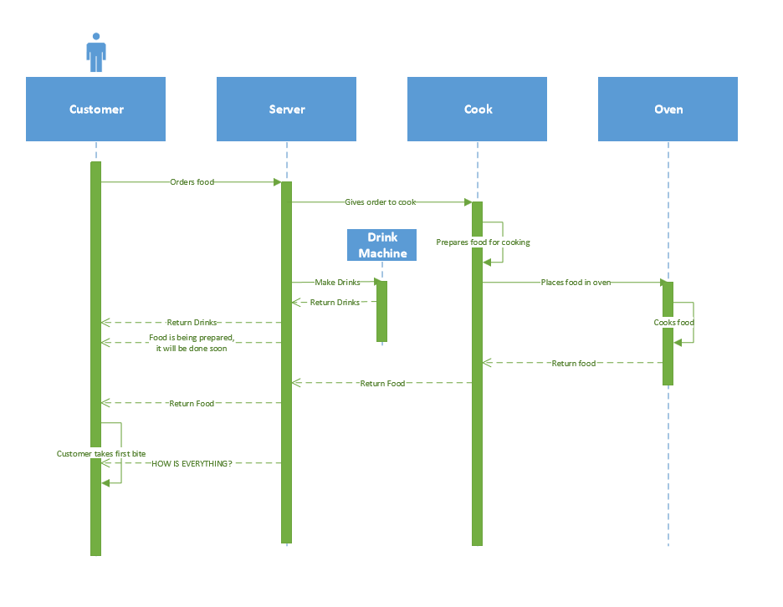
Example 1 in real life: Ordering food at a restaurant

Slide 6
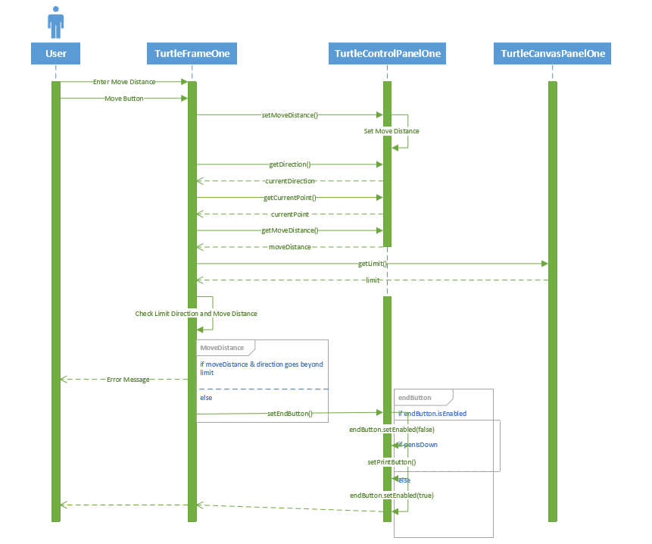
Example 2 in a program: Etch-a-sketch program from CIT 262

